Slide 2
Azure Deep Dive
Rob Bell

Slide 3
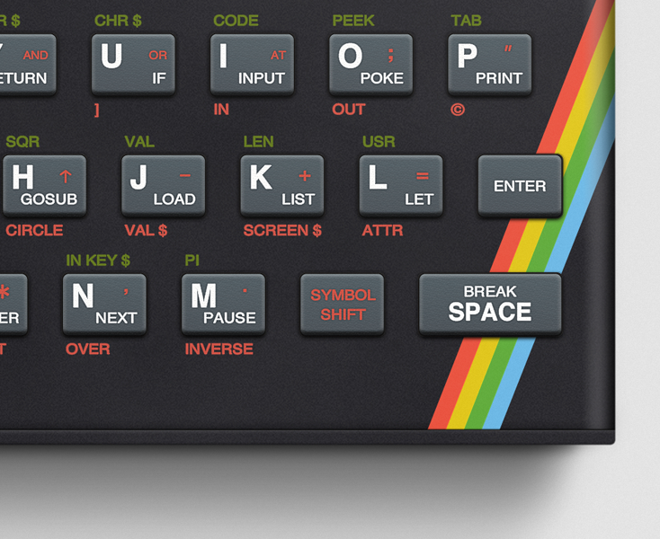
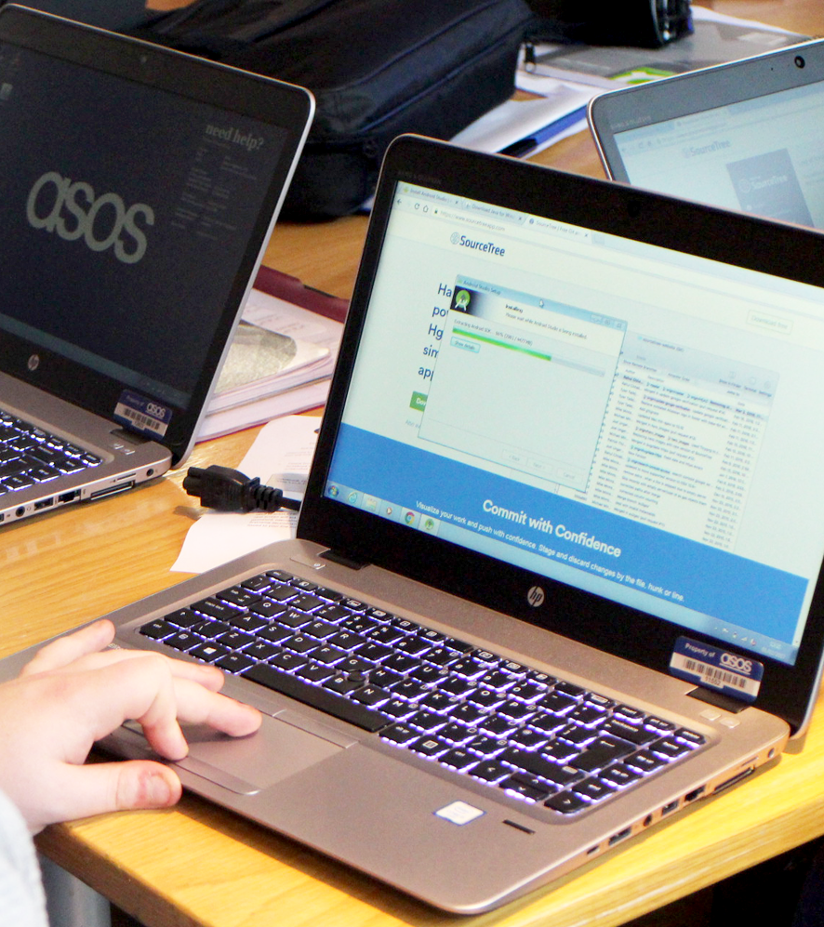
Rob Bell
Lead Software Engineer
Over 20 years writing code and over a decade as a professional developer
First code I wrote was for the ZX Spectrum
After that, I worked my way through the book The C Programming Language
Built HTML web pages in Microsoft Frontpage on my first PC
Since then I’ve written code in C++, Java, JavaScript, PHP, Delphi, Coldfusion, C#, VB, Scheme, F#...
Notes:
Over 20 years writing code and over a decade as a professional developer
I wrote my first code for my uncle’s ZX Spectrum, in a language called Basic – question to room
I figured that if I could display a pixel on screen and respond to user input, I could build anything
I worked my way through the book The C Programming Language, I wrote code samples on pencil and paper as I didn’t have a computer at the time
When I finally did get my first PC, I built web pages in HTML using Microsoft Frontpage
Since then I’ve written code in C++, Java, JavaScript, PHP, Delphi, Coldfusion, C#, VB, Scheme, F#...

Slide 4

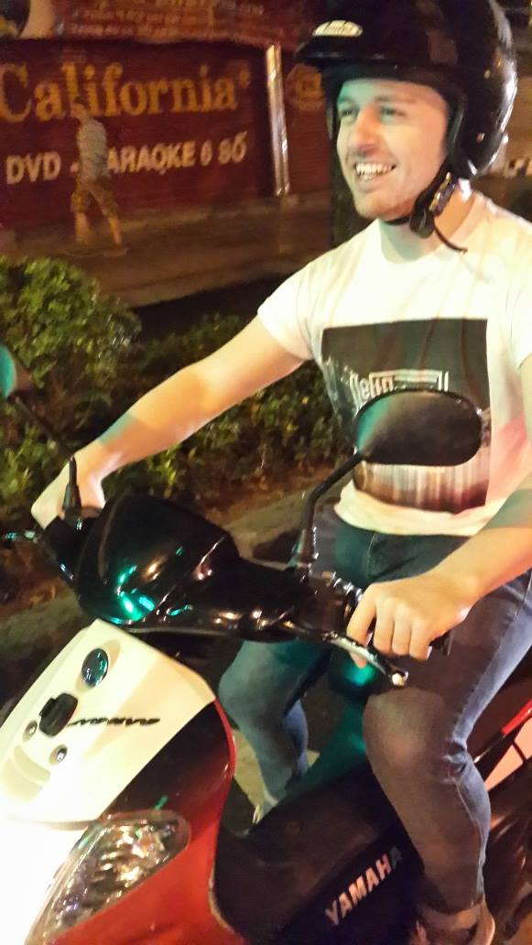
Rob Bell
Lead Software Engineer
My first job as a developer was for a media company, before moving into the insurance and finance sector
Built a software development team in Vietnam
Moved back home and had a brief stint as a technical architect
Moved to ASOS where I work for the Asset and Sizing platforms
Notes:
My first job was for a small media company which was also a charity
Small team of three devs, great freedom to build whatever we thought would help the organisation
Podcasting, with audio coming straight from the studios
After that I moved into insurance and finance
Code audits, lots of bureaucracy
After a few years there I got the opportunity to start a development team in Vietnam

Slide 5
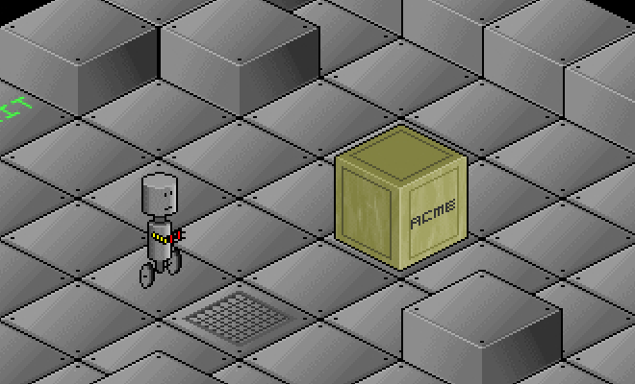
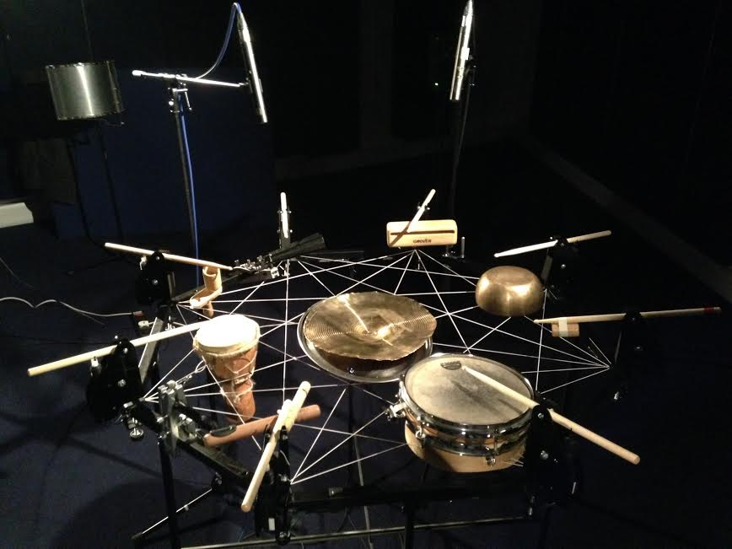
Rob Bell
Lead Software Engineer
Side projects include:
Creating games
Hackathons
Writing code to power sound and light installations
Building robot drum machines
I blog about some of it at rob-bell.net
Notes:
In my spare time I’ve built games and I’ve written code to power sound and light installations and robot drum machines
The game is called Rob-O-Tronic and it’s a slide puzzle, written as part of my dissertation at university
The drum machine was programmed by visiting a website and entering a musical score
It was on display at the Natural History Museum and the V&A
I blog about some of it at rob-bell.net

Slide 6
Part 1: Azure Resources

Slide 7
Why use the cloud?
“Cloud computing is just using somebody else’s computers”
Notes:
Put the question out to the team
It is correct, but a very simplistic view
Cloud computing provides so much more

Slide 8
Information technology as a utility, not a burden
Notes:
Electricity as an example
Everyone running their own generators requires lots of time, skill
Less reinventing the wheel – quote
Pay for what you need

Slide 9
Why use the cloud?
Availability
Flexibility
Security
Maintenance
Notes:
Availability – self healing.
Server failures, another takes over. Datacentre failures, another takes over.
Geo-located
Flexibility
Both scalability (up and down, out and in) and density options
Move resources to regions where they're required
Security
Microsoft’s experience of securing services, many experts, combined knowledge
Specialist tools not available in on-premise scenarios
Maintenance
Patching, disk changes, other hardware, downtime, server moves, everything tied to a specific piece of hardware
Share the story of the old GS2 image servers at ASOS

Slide 10
Why use the cloud?
AI
Intelligent Services
Planet-Scale Databases
Notes:
Cloud-only services
Planet-scale databases
AI services
Cognitive service – speech, vision
Less re-inventing the wheel

Slide 11
Why Azure?
“Microsoft are money-grabbing *********s”
Notes:
Put question to group
Microsoft’s recent move to be open first, developer friendly

Slide 12
Why Azure?
Familiarity
Cost
Resources
Notes:
Familiarity for .NET engineers, languages and resource types, lift and shift => Iaas to Paas to Saas
Certain services very affordable, Windows licences subsidised
Range of resources available is more than competitive with other cloud providers
Cognitive services only available via the cloud
AI used by Uber
Cognitive services including vision and speech
Global scale databases
Customers include:
Apple iCloud – cloud storage and other services
eBay – web app
Adobe – online services
Ubisoft - games
Samsung - IoT
Government agencies – compliance levels – Azure Stack to use Azure concepts on-premise

Slide 13
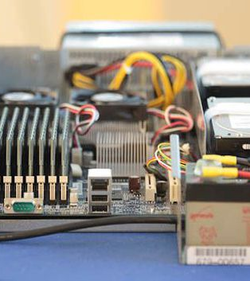
Compute Options
But I just want to run ‘Hello, World’!
Virtual Machines (VMs)
VM Scale Sets
Cloud Services
App Services
Service Fabric
Containers
Container orchestrators
Azure Functions
Probably a dozen more since creating this slide…
Notes:
VMs – complete control over the machine (IaaS)
SS – ability to scale and replicate reliably
Cloud Services – MS’s first attempt at PaaS – forget about the OS and runtime to some degree
App Services – MS’s next attempt at PaaS
Service Fabric – introduces orchestration, somewhat PaaS, introduces some of its own concepts too – “reliable services” – also supports containers…
Containers – somewhere between Iaas and Paas – but introduce packaging of applications, isolation
Orchestrators – handle running multiple containers
Azure Functions – functions as a service – stateless, very scalable, fixed paradigm
Image is Google’s first server – built using largely consumer parts, compared to other companies’ expensive super computers

Slide 14
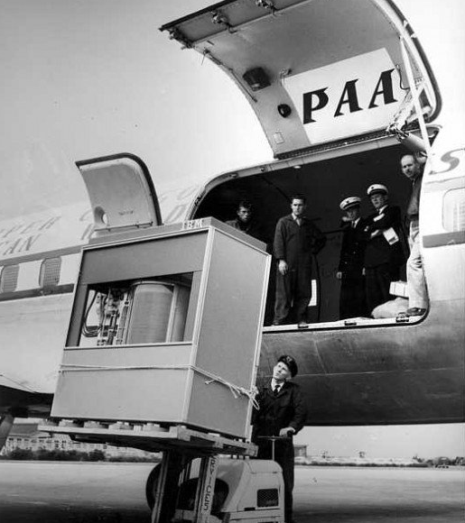
Database Options
DELETE FROM OrderInformation
-- WHERE Id = 582
SQL Azure for relational data
CosmosDB for documents, graphs, everything else
Redis as a caching layer
Notes:
SQL Azure
Managed version of SQL server
“Traditional” relational database
CosmosDB
NoSQL database
Schemaless
Huge scale
Multi-paradigm – document based, graph
Cassandra – high availability
Gremlin – graph based
MongoDB – well-known NoSQL DB for .NET devs, driver eases transition
SQL – uses well-understood SQL syntax
Table – move from Azure Table Storage and gain high availability, low latency...
Mutliple consistency, latency options – eventual consistency vs strong consistency
Redis
Persistent to some extent
Designed as a low-latency cache for super fast reads
Image is a 5MB HD in 1956

Slide 15
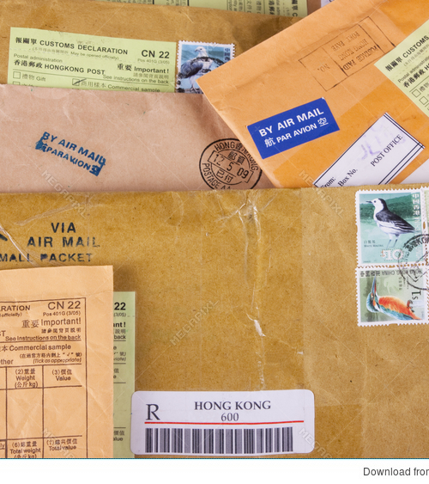
Service Bus
Why would I ever need that?
Traditional communication is request/response
What happens is the receiver is unavailable?
Messaging improves reliability
Messaging patterns improve flexibility
Notes:
Traditional communication is request/response
What happens is the receiver is unavailable? Question to the group
Direct calls are ok, but this is the next level for building distributed systems
Distribute workloads
Account for service downtime
Ensure requests are processed
Maybe slides for each of the above
Filters, security, simple forwarding

Slide 16

Azure Resource Manager
repeatability, repeatability, repeatability, repeatability
Perform repeatable deployments
Group dependent resources
Manage infrastructure and security
Configure varied resources in a consistent way
Notes:
Perform repeatable deployments – deployments will either succeed or rollback, audit trail is kept
Group dependent resources – no worrying about what has been provisioned, explicit dependencies can be created
Manage infrastructure and security – add firewall rules, virtual networks, roles, create user accounts and restrictions
Configure varied resources in a consistent way – all resources have the same format

Slide 17
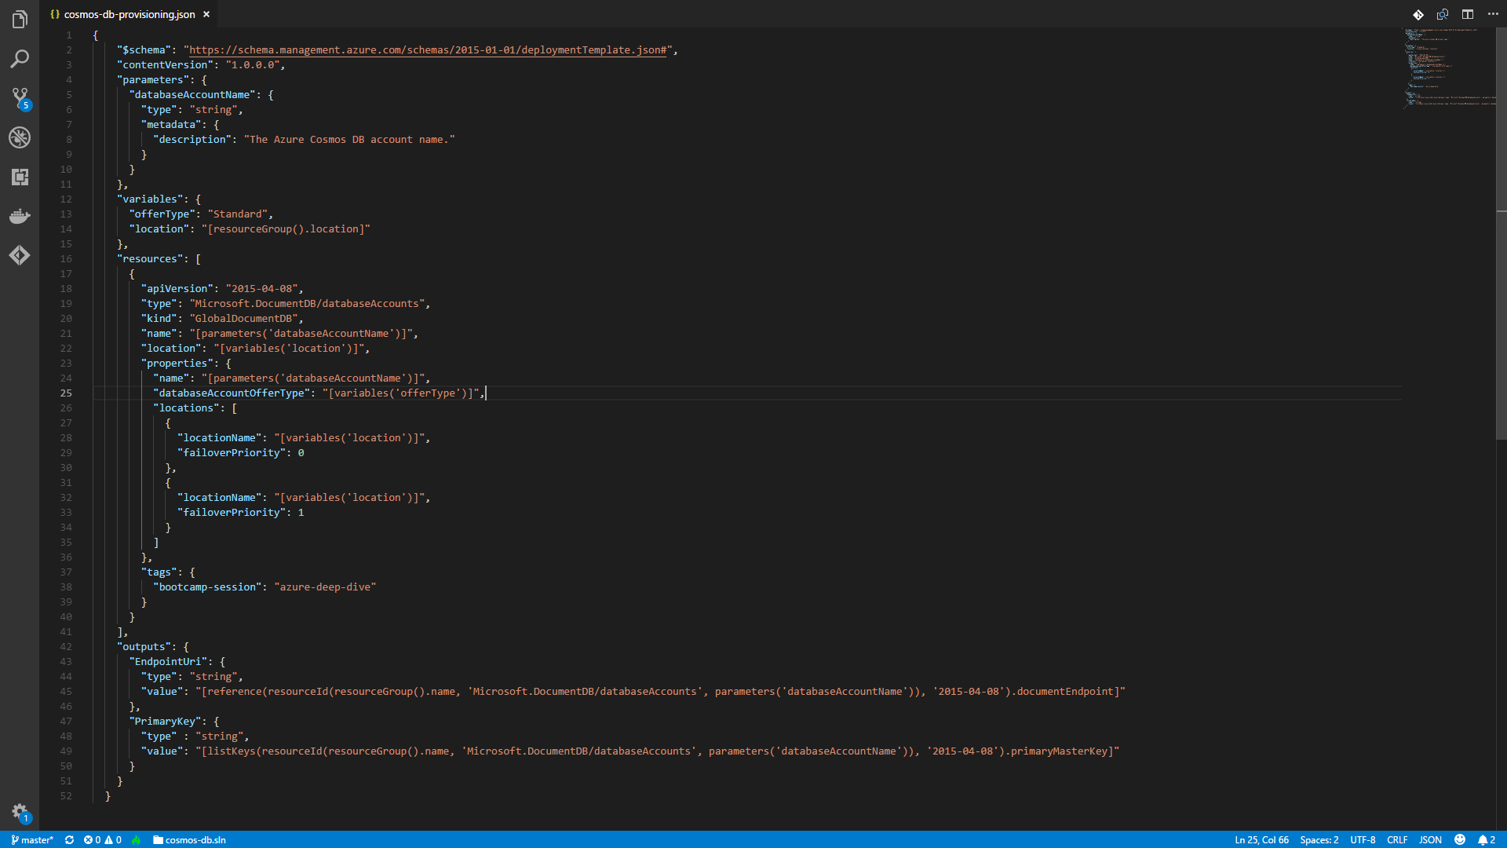
Notes:
Parameters for user input, allows defaults
Variables for clarity, calculated fields
Resources, can be nested, can be marked as dependsOn
Outputs, used to output keys etc. to be used elsewhere
Templates themselves can be nested
Can combine to build the entire architecture for an application
Only changes are applied, if no differences are found, nothing happends

Slide 18
Notes:
Parameters for user input, allows defaults
Variables for clarity, calculated fields
Resources, can be nested, can be marked as dependsOn
Outputs, used to output keys etc. to be used elsewhere
Templates themselves can be nested
Can combine to build the entire architecture for an application
Only changes are applied, if no differences are found, nothing happends

Slide 19
Notes:
Parameters for user input, allows defaults
Variables for clarity, calculated fields
Resources, can be nested, can be marked as dependsOn
Outputs, used to output keys etc. to be used elsewhere
Templates themselves can be nested
Can combine to build the entire architecture for an application
Only changes are applied, if no differences are found, nothing happends

Slide 20
Notes:
Parameters for user input, allows defaults
Variables for clarity, calculated fields
Resources, can be nested, can be marked as dependsOn
Outputs, used to output keys etc. to be used elsewhere
Templates themselves can be nested
Can combine to build the entire architecture for an application
Only changes are applied, if no differences are found, nothing happends

Slide 21
Notes:
Parameters for user input, allows defaults
Variables for clarity, calculated fields
Resources, can be nested, can be marked as dependsOn
Outputs, used to output keys etc. to be used elsewhere
Templates themselves can be nested
Can combine to build the entire architecture for an application
Only changes are applied, if no differences are found, nothing happends

Slide 22
https://resources.azure.com/

Slide 23
Labs

Slide 24
https://github.com/robbell/azure-deep-dive
git clone https://github.com/robbell/azure-deep-dive

Slide 25
Part 2: Architecting for the Cloud

Slide 26
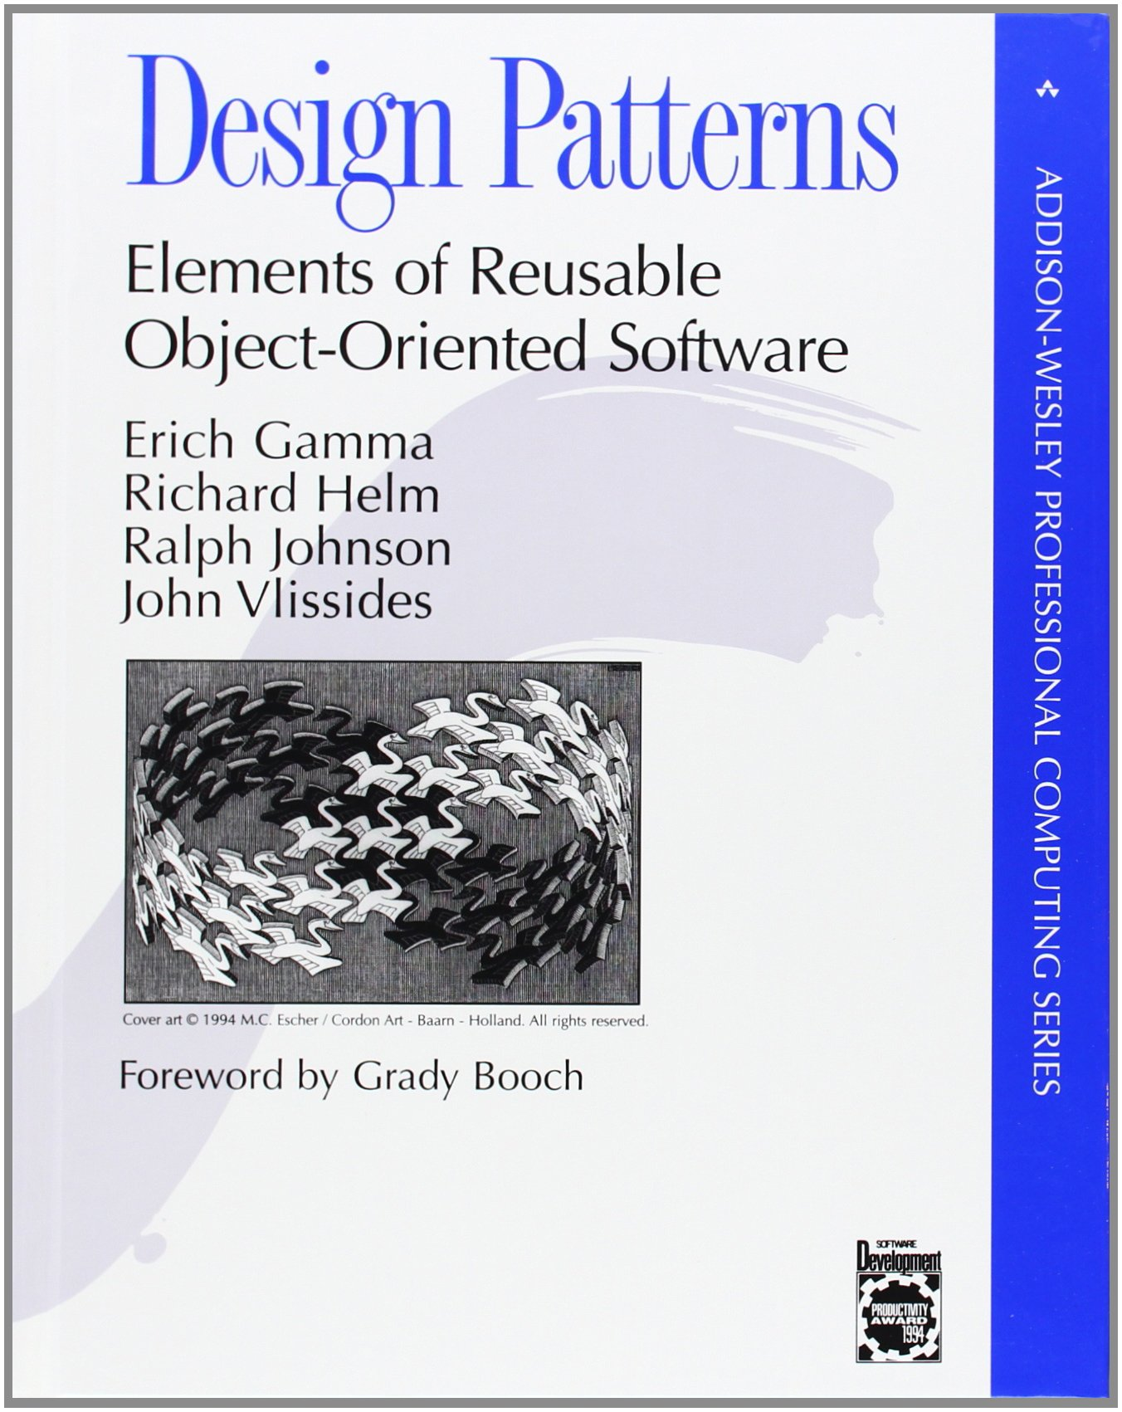

Slide 27
General, repeatable solutions to commonly occurring problems

Slide 28
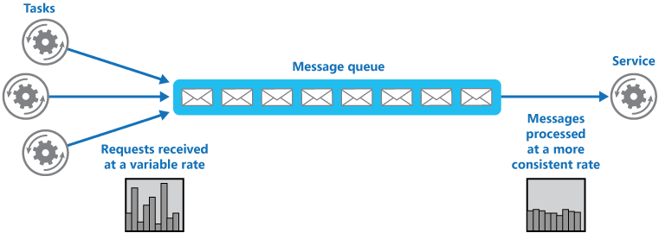
Queue-based load levelling
Notes:
Buffer to provide predictable load to a service

Slide 29
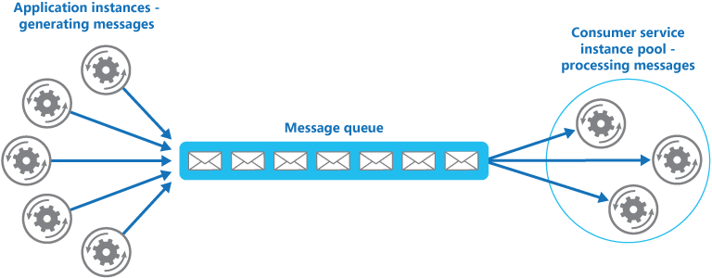
Competing consumers
Notes:
Increase throughput by introducing new workers, balance workload

Slide 30
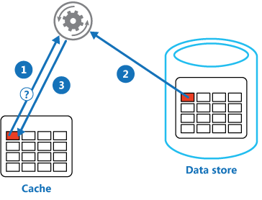
Cache aside
Notes:
Use a specialised store to handle repeated calls which would normally lead to more resource intensive requests
Implemented using a specialised caching product like Redis, or even a NoSQL database like Cosmos in a key-value configuration
How to handle consistency?

Slide 31
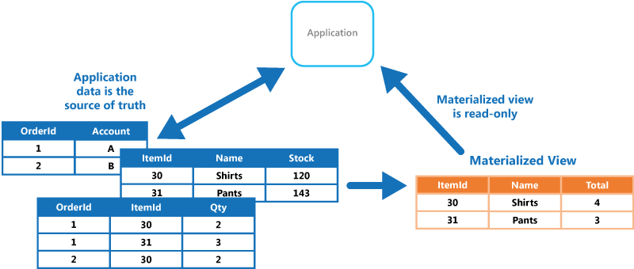
Materialised view
Notes:
Similar to a cache, but pre-empted
In Azure, we might take several SQL tables and flatten then down into a Cosmos document when that data is ready for publication
How to handle consistency?

Slide 32
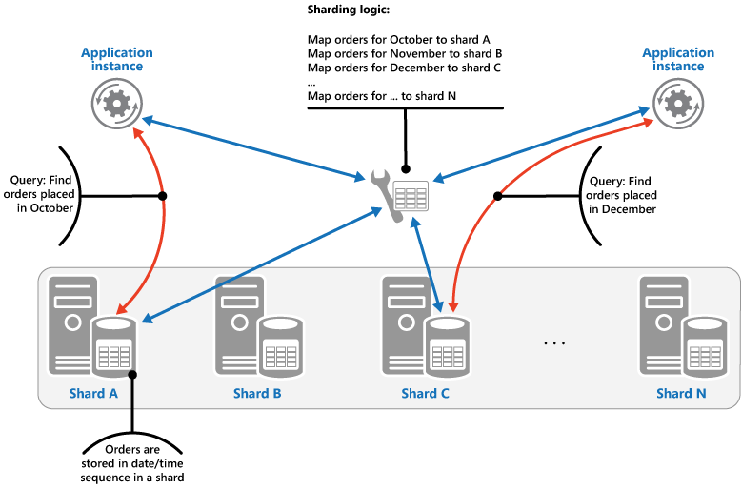
Sharding
Notes:
Divide a data store into horizontal partitions
Can improve scalability when handling large volumes
Requires up front knowledge of the shape of data/requests

Slide 33
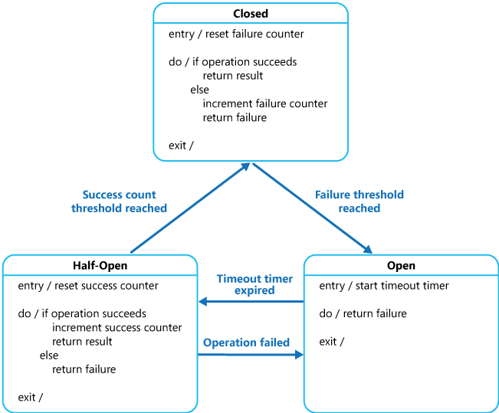
Circuit breaker
Notes:
Handle faults that might take a variable amount of time to recover from, when connecting to a remote service or resource. This can improve the stability and resiliency of an application.

Slide 34
Labs

Slide 35

Pharmacorp
A better you, today!
We’re planning to launch a new app for our patients
We have a lot of stable services which support the app, but one very old service which goes down for long periods at a time
We want patients to be able to use the remaining functionality even when the old service is down
All customer interaction is done based on their surname

Slide 36

Messngr
Talk, talk, talk! Never switch off!
We want to take group chat to the next level – hundreds of people all communicating at once
We want to guarantee that all messages are sent to all of our clients
All files sent between clients should be downloadable for 30 days after they’re sent

Slide 37

Readr
Because my opinion matters!
We want to provide advance editing tools to our writers, lots of editing options and a full history of changes
We anticipate that we’ll receive huge numbers of requests from across the globe
We want to get our opinions into our readers’ minds as quickly as possible
We don’t care about our readers’ opinions, so once something’s published, it’s final

Slide 38

Telly
More cat clips than you can shake a stick at
We want to be the number one viral clips destination
We only have one old server that can perform video encoding
We don’t want our content creators to have their uploads rejected
Longer-term we plan to add more encoders – what can we do to support that?

